Slide 1

Screen Time in India
Understanding Children's Digital Habits

Slide 2
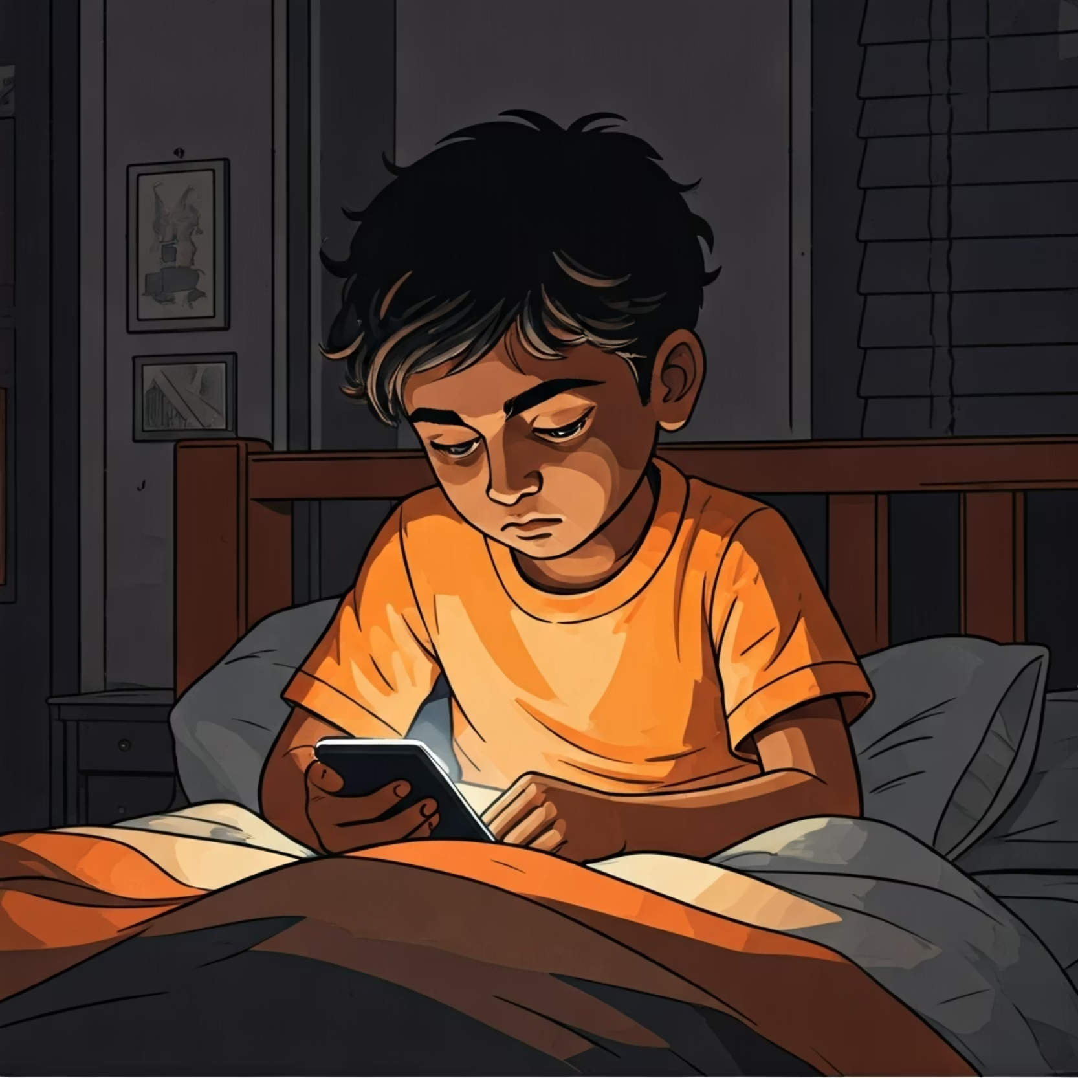
Indian children are spending unprecedented amounts of time on digital devices, often late into the night. This shift represents a fundamental change in childhood experiences.
The Digital Dilemma
The Challenge
The consequences extend beyond simple screen exposure—affecting sleep patterns, outdoor activity, and social development.

Slide 3



Core Objectives
Analyze Patterns
Health Impact
Strategic Solutions
Examine screen time data across age groups, locations, and device types to identify usage trends
Understand correlations between digital habits and physical and mental wellness outcomes
Develop evidence-based recommendations for healthier digital engagement

Slide 4

Tools & Methodology
01
Data Collection
Gathered comprehensive screen time data from diverse Indian households
02
Python Analysis
Applied advanced statistical methods to identify patterns and correlations
03
Power BI Visualization
Created interactive dashboards to communicate findings effectively
04
Insight Generation
Synthesized data into actionable recommendations for stakeholders

Slide 5
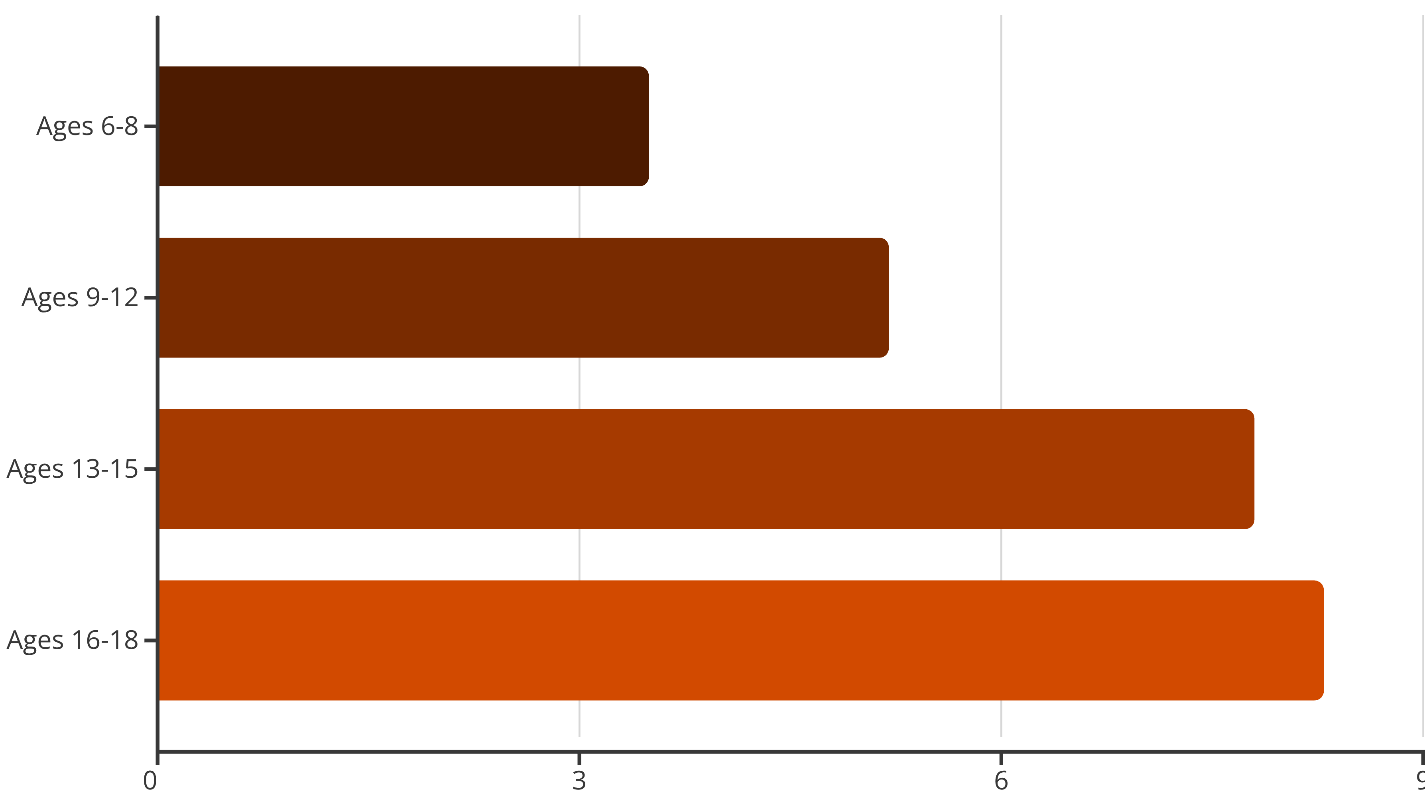
Screen Time Crisis
Teenagers Lead in Daily Digital Consumption
Adolescents between 13-18 years old spend over 8 hours daily on screens—exceeding sleep time for many. This dramatic increase correlates with smartphone ownership and social media engagement.

Slide 6

Location & Device Trends
Universal Access
Digital device penetration has reached both urban metros and rural villages, with smartphones becoming the primary gateway.
82%
64%
Urban Reach
Rural Reach
Children with devices
Growing connectivity

Slide 7


Quality Imbalance
Educational vs. Recreational Screen Time
28%
72%
Educational Content
Entertainment
Online learning and homework
Games, social media, and videos
While devices offer educational opportunities, the majority of screen time is spent on recreational activities. This imbalance raises questions about digital literacy and parental guidance.

Slide 8

Health Consequences
Sleep Disruption
Mental Health
65% of high screen-time users report difficulty sleeping and irregular sleep schedules, directly impacting academic performance and growth.
Increased anxiety and mood disorders correlate with prolonged social media exposure and comparison-based content consumption.
Physical Strain
Eye fatigue, headaches, and poor posture affect over half of children spending 6+ hours daily on devices.

Slide 9





Actionable Strategy
Building Healthier Digital Habits
Set Time Limits
Implement age-appropriate daily screen time boundaries with device-free hours
Encourage Outdoor Activity
Promote physical play, sports, and nature exploration as alternatives to screens
Quality Content
Prioritize educational and creative content over passive entertainment
Family Engagement
Model healthy behavior through shared screen-free activities and open communication

Slide 10

Future Vision
Next Steps
1
AI-Powered Monitoring
Deploy predictive analytics to identify at-risk patterns early
2
Expand Research
Longitudinal studies tracking long-term developmental impacts
3
Policy Recommendations
Collaborate with educators and policymakers on digital wellness frameworks
Through continued research and technology-enabled solutions, we can create a future where children thrive in both digital and physical worlds.

